Slide 1


Slide 2


Slide 3


Slide 4

Faith’s Exploit for the Lord
1 Samuel 14:1-23

Slide 5
Gen 18:14a Is any thing too hard for the LORD?

Slide 6
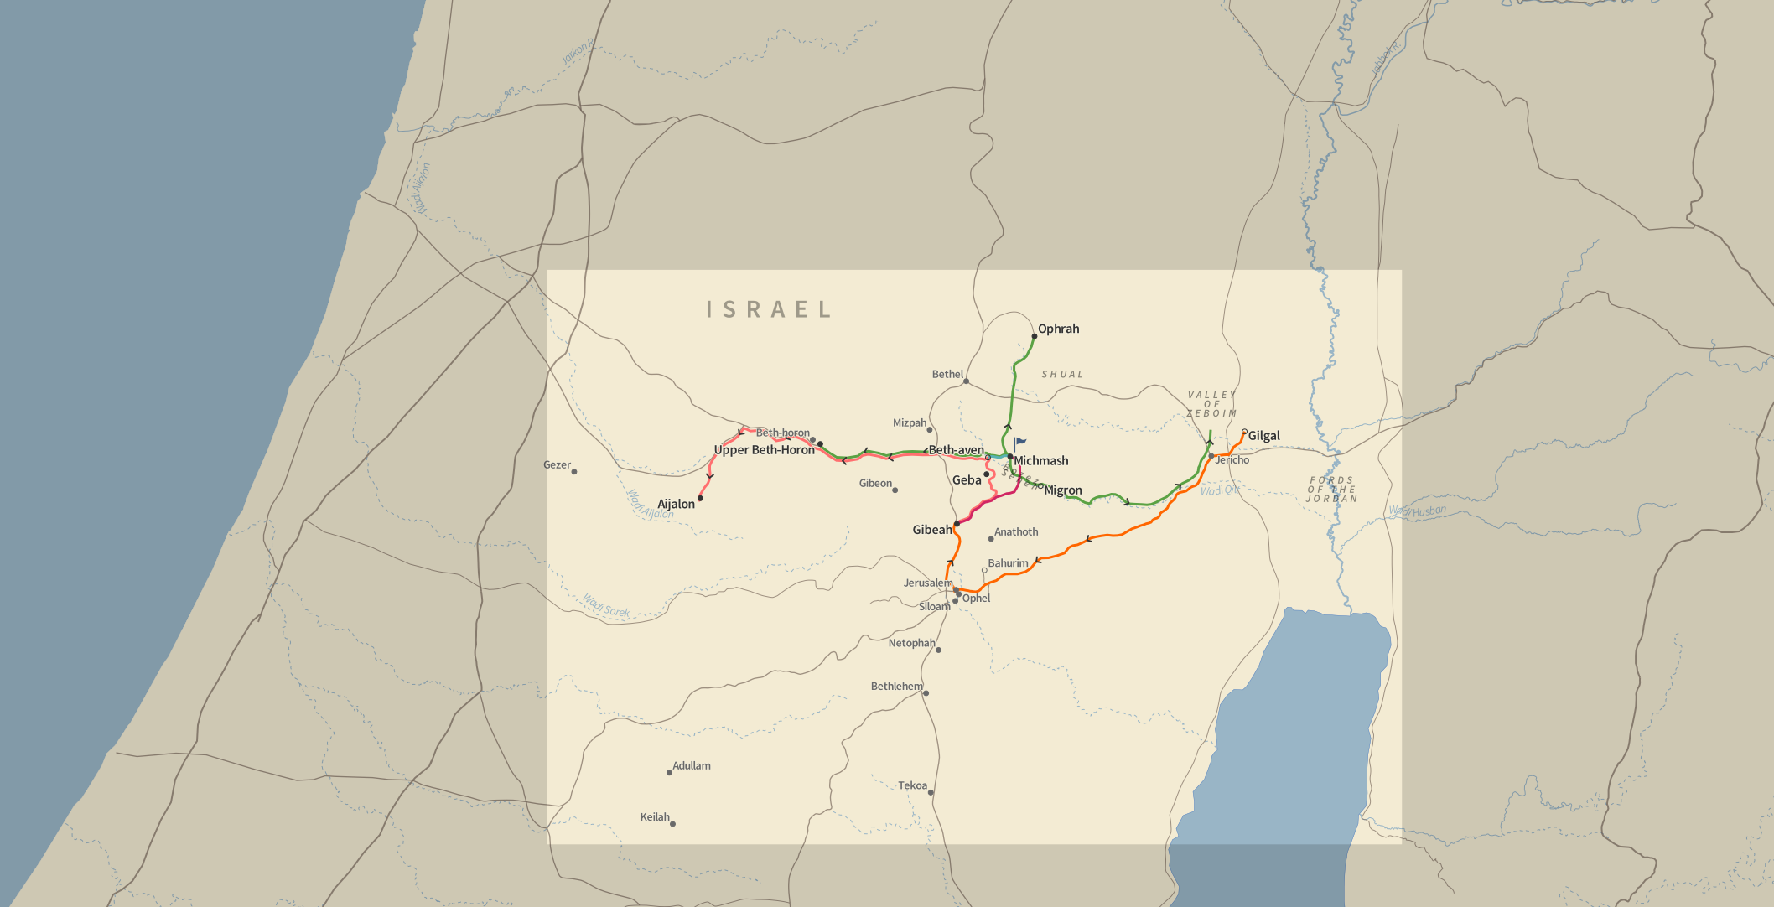
Jonathan’s Faith

Slide 7

Saul’s Faults
He isn’t in the battle.
He’s lounging in the shade.
At “Migron” = precipice.
He is with 600 men.
He is hanging with rejects.
Saul was hiding out in failure and unbelief.

Slide 8
Psalm 94:7 Yet they say, The LORD shall not see, neither shall the God of Jacob regard it.
Proverbs 30:20 Such is the way of an adulterous woman; she eateth, and wipeth her mouth, and saith, I have done no wickedness.

Slide 9







Slide 11
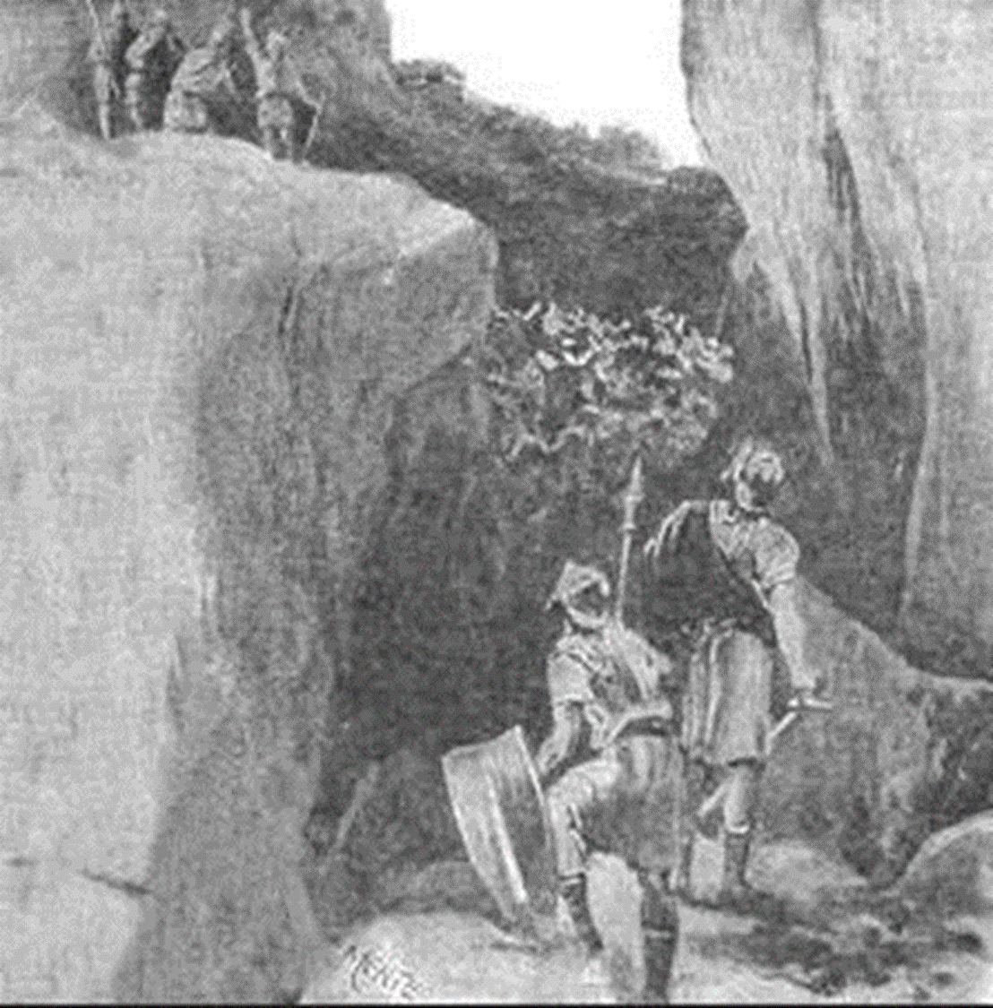
Moving forward in faith
Faith finds agreement.
Faith knows the facts of the Word of God.

Slide 12
Leviticus 26:7-8 And ye shall chase your enemies, and they shall fall before you by the sword. 8 And five of you shall chase an hundred, and an hundred of you shall put ten thousand to flight: and your enemies shall fall before you by the sword.

Slide 13
Deuteronomy 28:7 The LORD shall cause thine enemies that rise up against thee to be smitten before thy face: they shall come out against thee one way, and flee before thee seven ways.

Slide 14
Judges 7:7 And the LORD said unto Gideon, By the three hundred men that lapped will I save you, and deliver the Midianites into thine hand: and let all the other people go every man unto his place.

Slide 15
Romans 8:31 What shall we then say to these things? If God be for us, who can be against us?

Slide 16
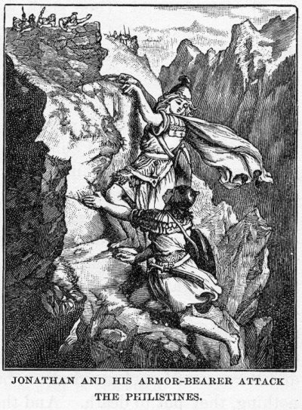
Jonathan’s faithful follower.
Be a faithful follower!
1 Corinthians 11:1 Be ye followers of me, even as I also am of Christ.
Philippians 3:17 Brethren, be followers together of me, and mark them which walk so as ye have us for an ensample.

Slide 17
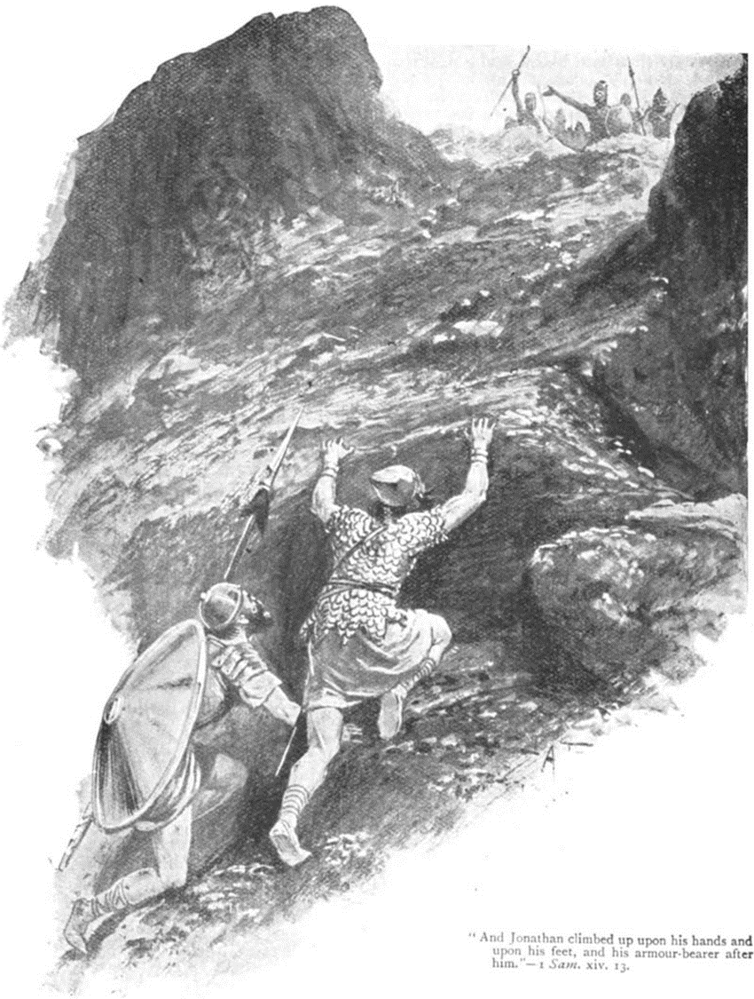

Slide 18
1 Corinthians 16:9 For a great door and effectual is opened unto me, and there are many adversaries.

Slide 19
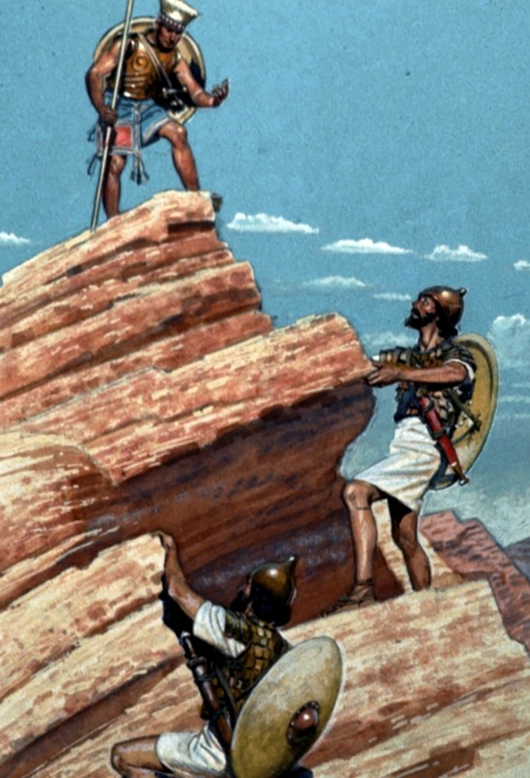
Proverbs 16:18 Pride goeth before destruction, and an haughty spirit before a fall.
TWO + JEHOVAH = INFINITY
Joshua 23:10 One man of you shall chase a thousand: for the LORD your God, he it is that fighteth for you, as he hath promised you.
Jonathan = “Jehovah has given!”

Slide 20
Notice the keys to victory.
We must have armour in order to stand in battle. Eph 6:10-18
The enemy could not STAND before Jon’s faith.
But notice: The armor did all the rest!
We must have unity in our mission.
We cannot stop until the work is done!

Slide 21
The Philistines fear.
The enemy of God’s people are only unified when they think they are winning against Him.
They don’t love each other. They are not for each other.
At the first sign of defeat, they turn on themselves.
A divided house cannot stand!

Slide 22
Luke 11:17-18a But he, knowing their thoughts, said unto them, Every kingdom divided against itself is brought to desolation; and a house divided against a house falleth. 18 If Satan also be divided against himself, how shall his kingdom stand?

Slide 23
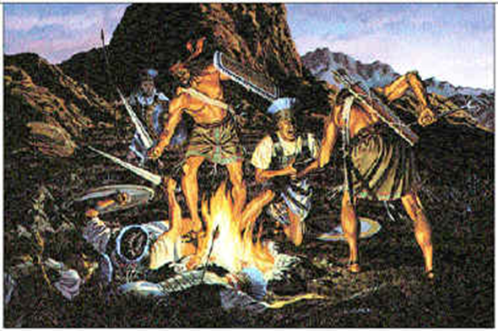
Saul’s folly.
  We need to be a continuing
  people of prayer.
Saul finally moves forward.
Judges 7:22a And the three
hundred blew the trumpets,
and the LORD set every man's sword against his fellow, even throughout all the host:
Notice how Jonathan’s on fire for God faith spreads!
  The traitors repented and began to fight.
  The cowards got bold in faith and began to fight.

Slide 24
1 Corinthians 1:27-29 But God hath chosen the foolish things of the world to confound the wise; and God hath chosen the weak things of the world to confound the things which are mighty; 28 And base things of the world, and things which are despised, hath God chosen, yea, and things which are not, to bring to nought things that are: 29 That no flesh should glory in his presence.

Slide 25
Faith’s Exploit for the Lord
1 Samuel 14:1-23

